Slide 1
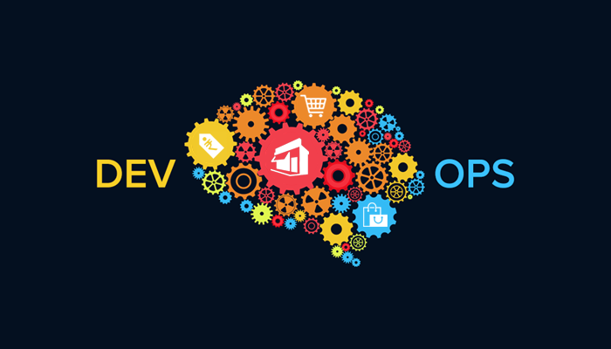
Introduction to
By, Chinnajee rao

Slide 2

About V. Chinnajee Rao
IT Infrastructure trainer with 18 + years of experience
Core – U & I
Certified – DevOps, AWS, RHEL,
Solaris , AIX, VMware

Slide 3

Contents
Introduction
What Is DevOps?
Do We Really Need DevOps?
Survey of DevOps Quantifiable Benefits
How Does DevOps Work Anyways?
Challenges and Problems Out There
7Cs of DevOps
How Will You Benefit From DevOps Approach?
Conclusion

Slide 4

DevOps

Slide 5
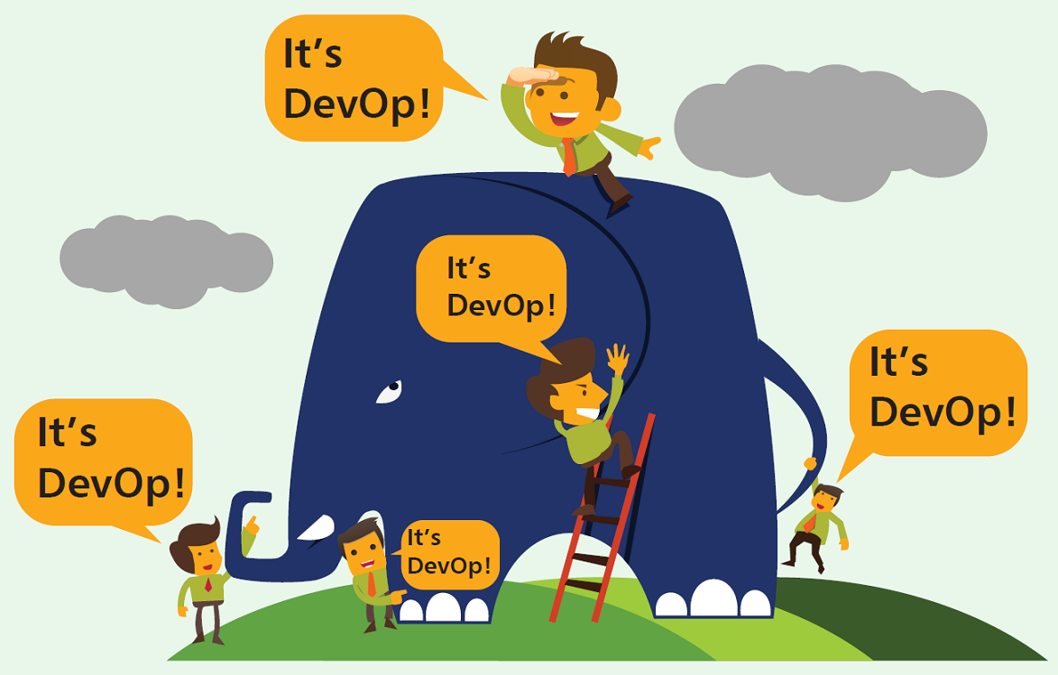
Why DevOps exist?

Slide 6
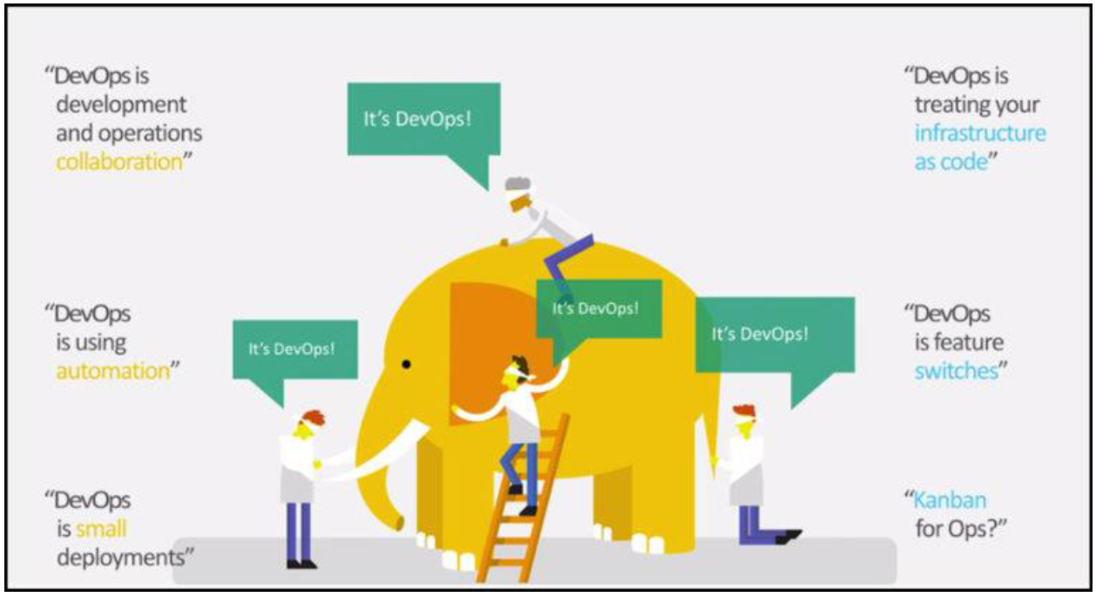
Why DevOps Exist

Slide 7
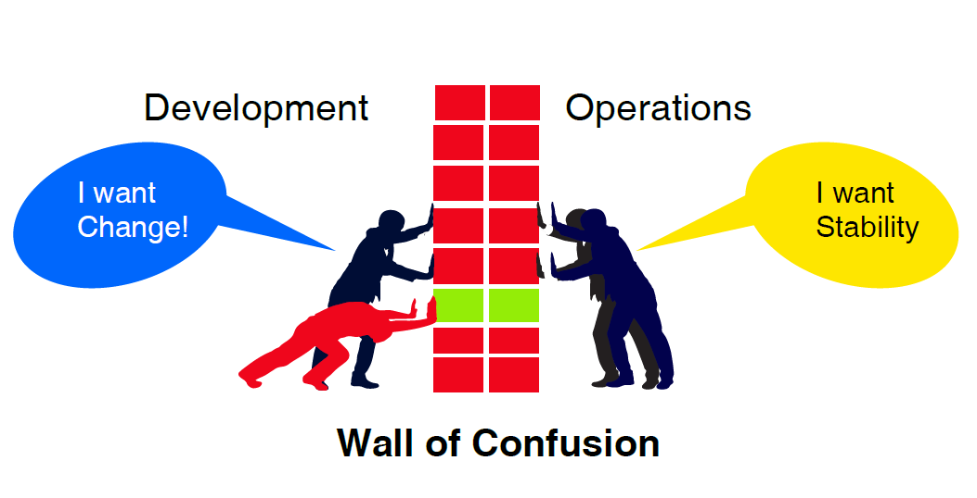
Do we really need devops?

Slide 8
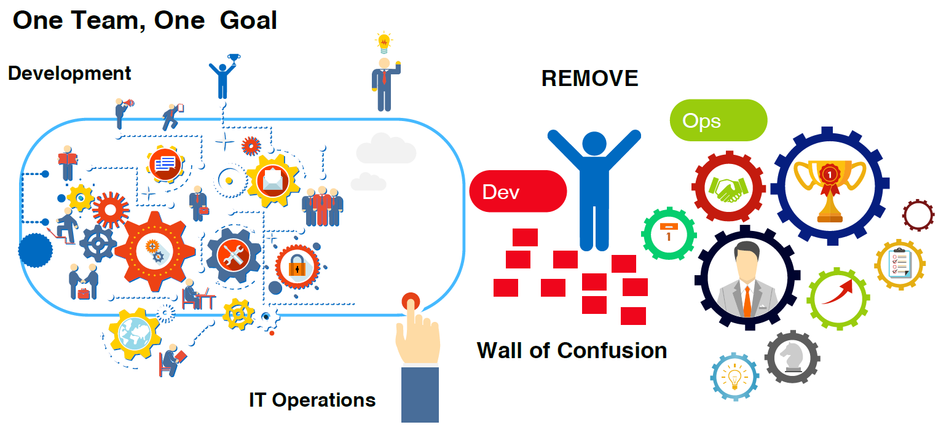
DevOps break down the walls between development and operations team

Slide 9
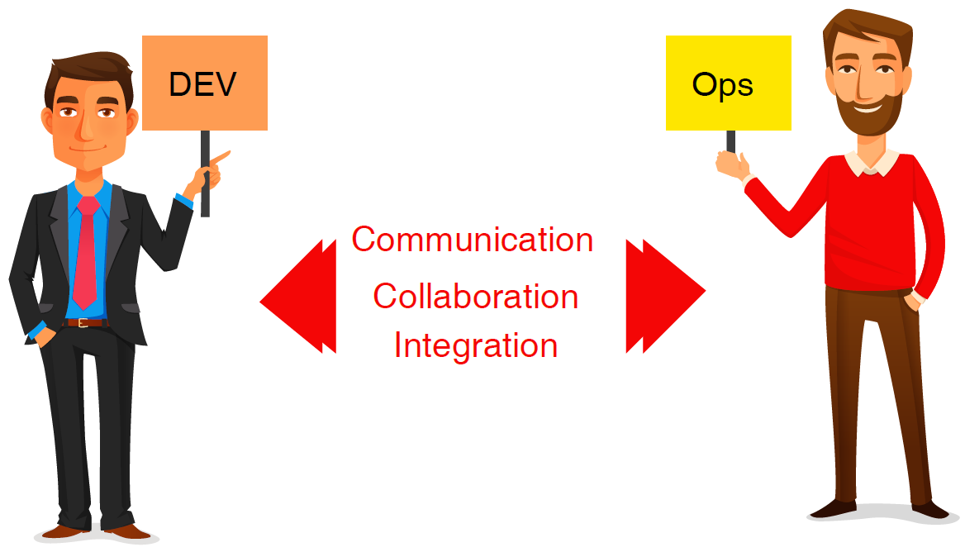
What is DevOps?

Slide 10
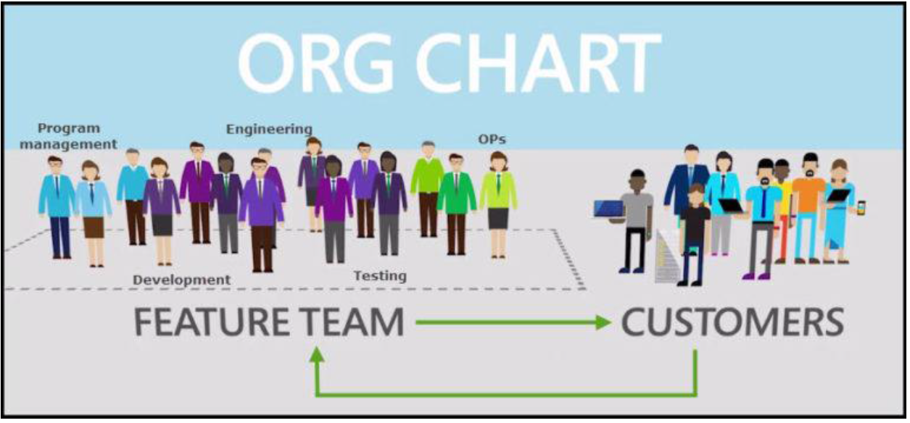
Bridge the gap between dev and ops

Slide 11
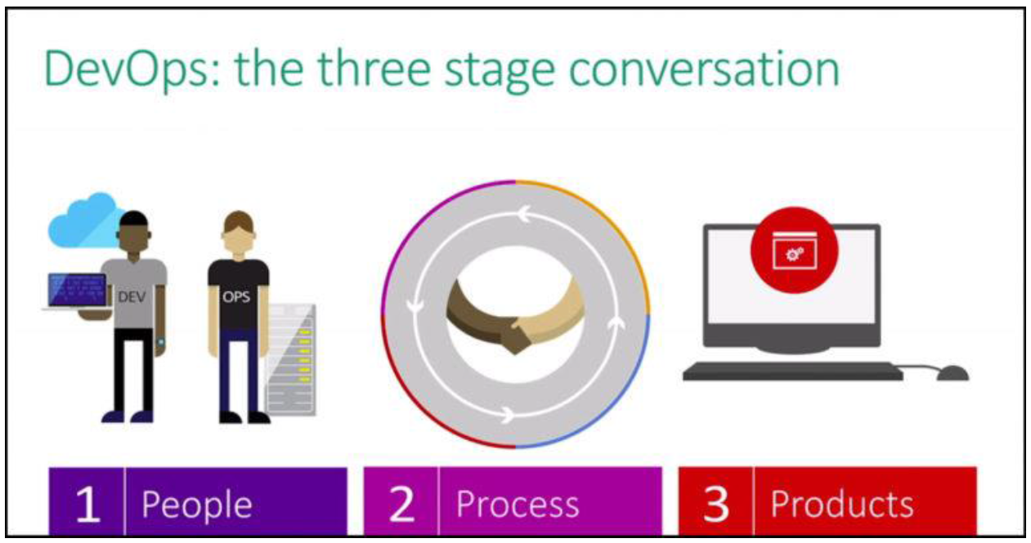
Correlation between PEOPLE, PROCESS AND PRODUCT

Slide 12
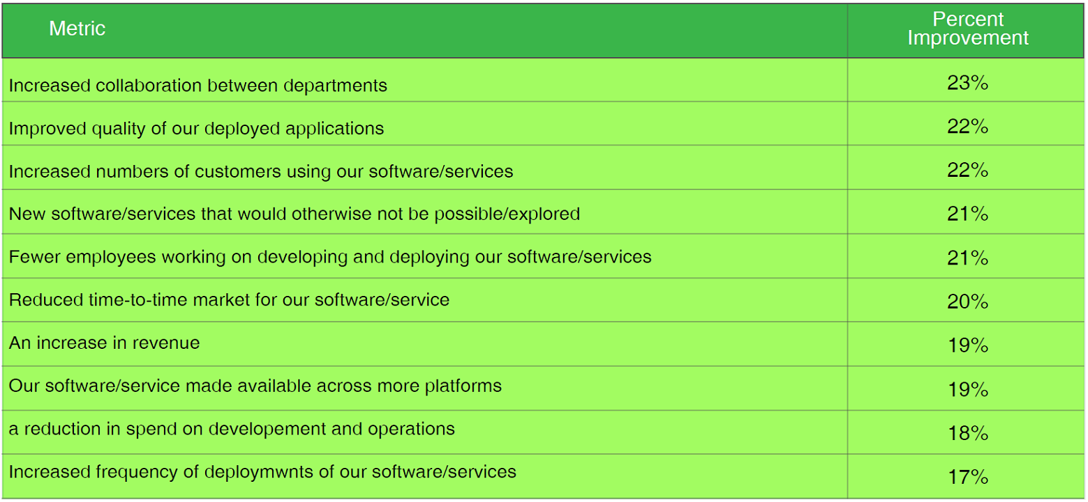
Survey of DevOps Quantifiable Benefits

Slide 13
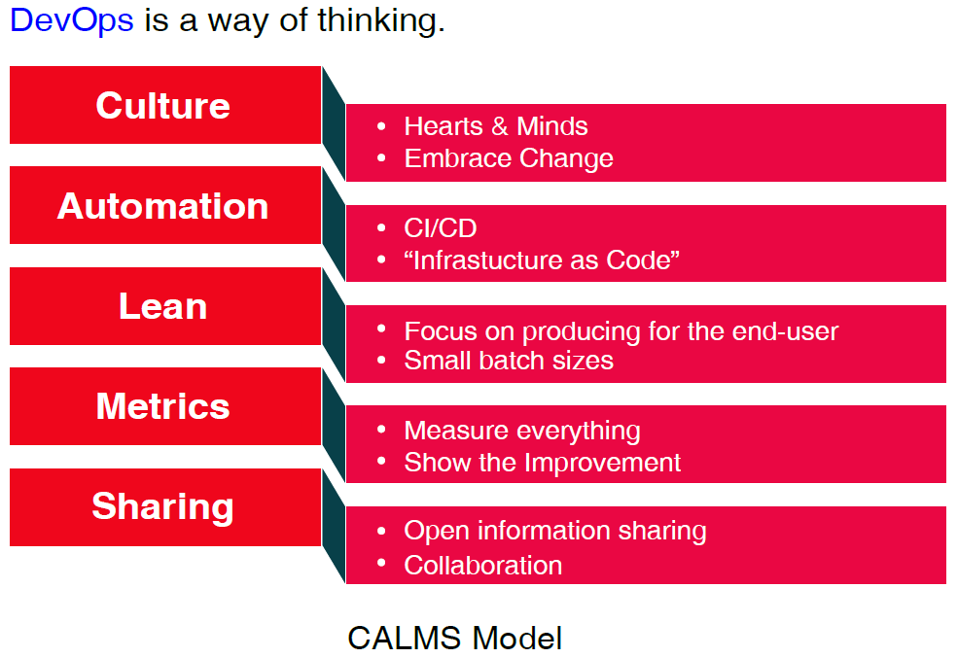

Slide 14
Culture
A DevOps culture changes the way businesses work, enabling teams to produce great results that make users happy.
A big part of the culture is breaking down the silos that exist within an organization, so that Dev and Ops can work better together towards the same goal – those happy users.
There’s no longer an It worked on my machine or It’s not my problem atmosphere. Now, it’s Let’s work together to make this the best experience for our users.

Slide 15
Automation
Automation is key when it comes to DevOps.
If you want to release more frequently, the release pipeline is a perfect candidate for automation.
It’s completely repetitive and automation will help eliminate any manual errors.
Continuous Integration with a thorough set of automated tests is important for automating releases.

Slide 16
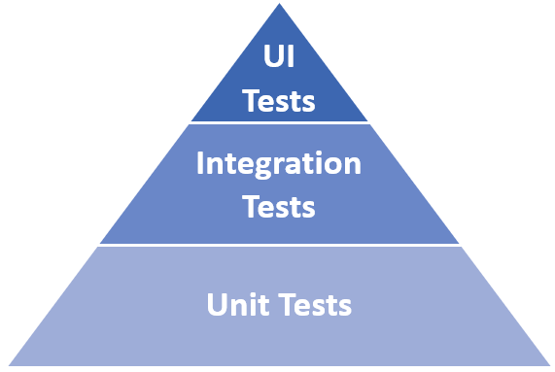

Slide 17
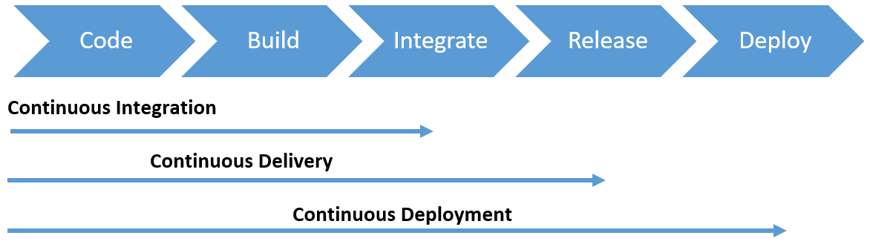

Slide 18
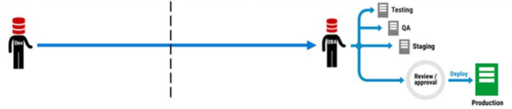
A typical deployment pipeline as a siloed process

Slide 19
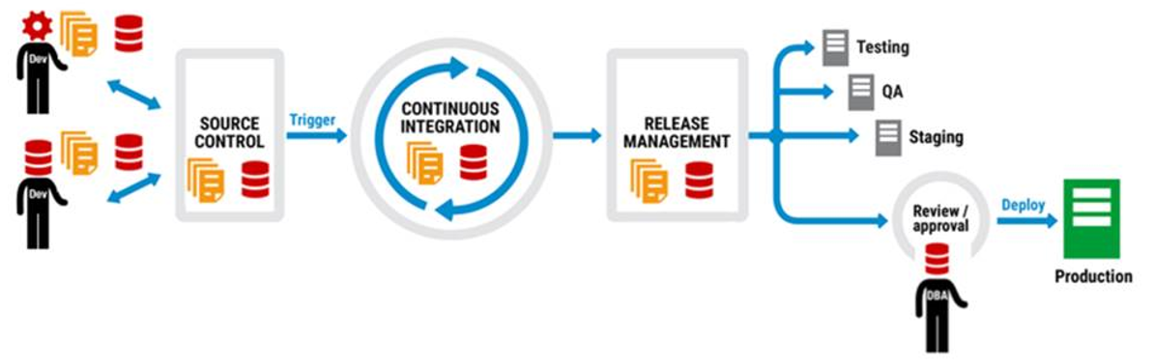
A typical deployment pipeline as a continuous delivery process

Slide 20
Lean
Lean is focused on incremental improvements and splitting the work into small batches.
The small batches allow you to release frequently as you develop.
This is important so that you can get real user feedback on your work and learn from it so that you can pivot and adjust according to what you learn as needed.

Slide 21
Measurement
Measuring is important to get quick feedback and continuously improve, because you can only know if you’re making a difference and improving if you have a baseline to measure against.
The first area to start measuring is your internal processes,
like how long it takes for committed code to be running on production,
the frequency of releases,
the failure rate, and t
he mean time to recover from a failure.

Slide 22
Sharing
Sharing brings us back to the first value, Culture.
If you want to make a huge impact on the culture, it’s important to share the lessons you’ve learned and your best practices with the rest of your company. This helps to break down those silos so that people work together to continuously improve and do what’s best for your users.

Slide 23
Conclusion
CALMS are important DevOps values,
which enable you to break down silos,
work better together, and
provide frequent value to users that can be continuously improved.

Slide 24
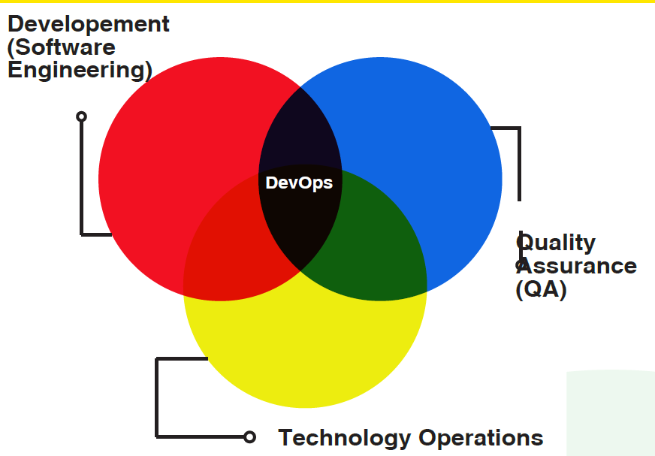
Collaboration of dev ops and qa

Slide 25
DevOps combines the best of all teams
As following:
Reduces cost/time to deliver
Deploy often, deploy faster with repeatable, reliable process
Increases Quality
Automated testing, Reduce cost/time to test
Reduces Defect cycle time
Increase the ability to reproduce and fix defects
Increases Virtualized Environments utilization
Reduces Deployment related downtime
Minimizes rollbacks

Slide 26
5 Basic principles of DevOps
Eliminate the blame game, Open post-mortems, Feedback, Rewarding failures
Continuous Delivery, Monitoring, Configuration Management
Business value for end user
Performance Metrics, Logs, Business goals Metrics, People Integration Metrics, KPI
Ideas, Plans, Goals, Metrics, Complications, Tools

Slide 27
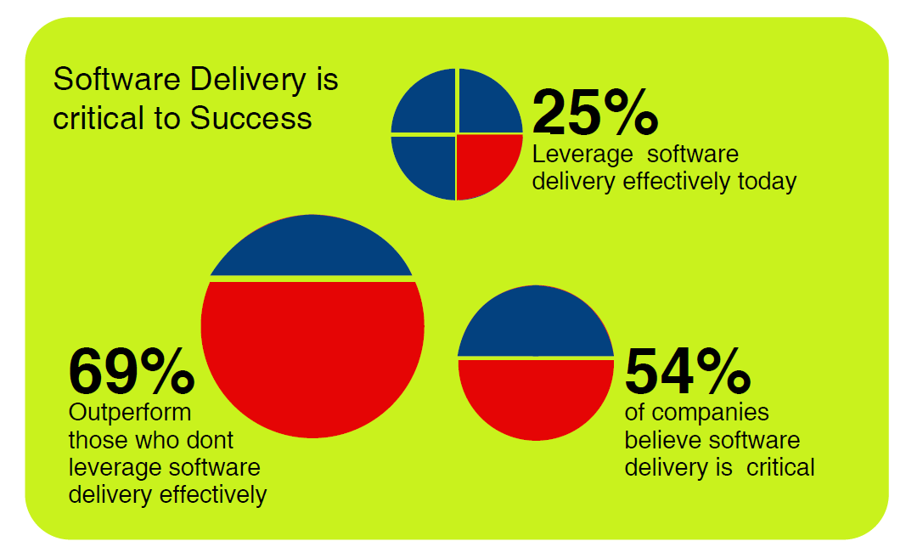
Challenges and problems out there

Slide 28
Some of the serious issues blocking your software delivery are:
No proper configuration management
Discrepancies in managing configurations
Deployments are a blocker
Upgrade risk due to manual management of multiple application configuration and versions - Dependency on specific deployment engineer
Production downtime
Due to lack of improper deployment instructions / checklist
Hacking
Fixing directly in production (instead of a proper hotfix process) and forgets to check-in into source control

Slide 29
Some of the serious issues blocking your software delivery are:
Building and maintaining servers
Time consuming and unproductive
No environment management
Differences in development and production environments
Slow deployments
Costly error prone manual process and efforts
No shared ownership
Lack of feedback and proper metric leads

Slide 30

So,
Realize your entire business gets impacted if you do not have Continuous Delivery.
To enable that, you must adopt DevOps

Slide 31
7Cs of DevOps
Communication
Collaboration
Controlled Process
Continuous Integration
Continuous Deployment
Continuous Testing
Continuous Monitoring

Slide 32
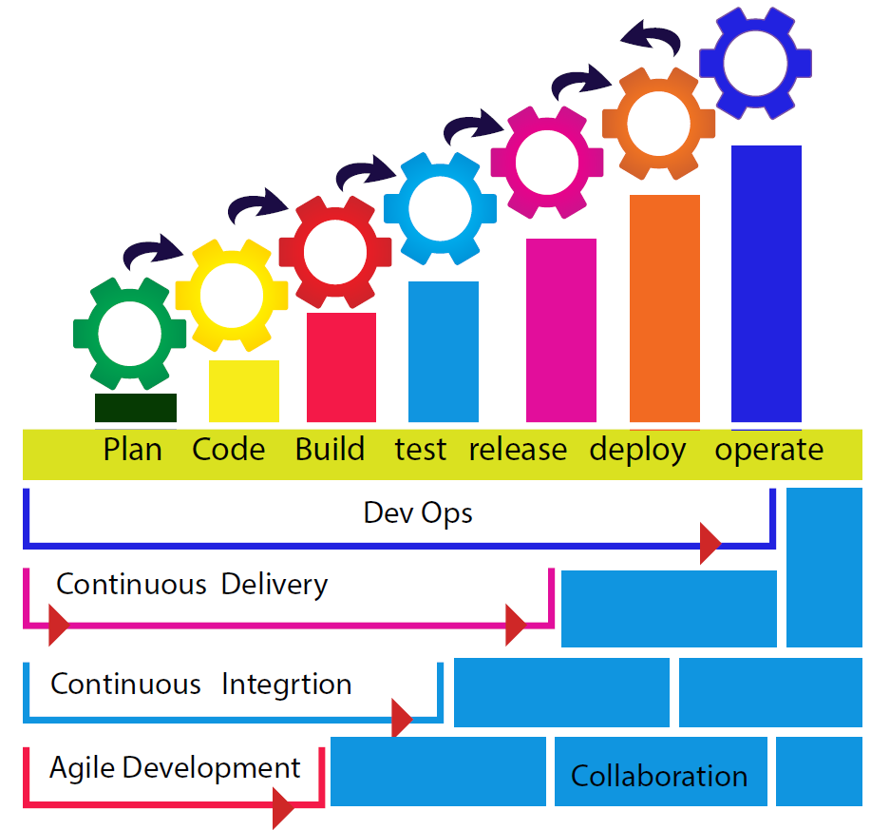
Towards Automation

Slide 33
Without automation there is no DevOps.
Automate Provisioning
Infrastructure as Code
Automate Builds
Continuous Integration
Automate Deployments
Defined Deployment Pipeline and Continuous Deployments with appropriate configurations for the environments

Slide 34
Without automation there is no DevOps.
Automate Testing
Continuous Testing, Automated tests after each deployment
Automate Monitoring
Proper monitors in place sending alerts
Automate Metrics
Performance Metrics, Logs

Slide 35
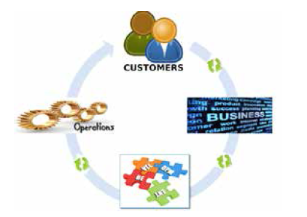
How will you benefit from DevOps approach
DevOps Approach defines the DevOps lifecycle as a Continuous on-going interactions and feedback between the Customers-Business-Development-Operations.

Slide 36
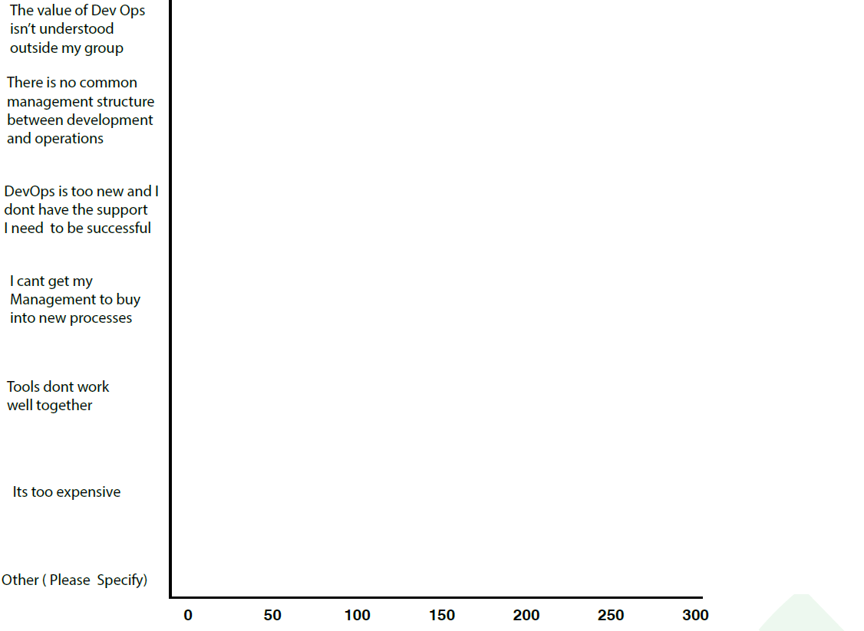







Barriers to DevOps Adoption

Slide 37










Some Companies who got DevOps Right

Slide 38
Job Roles in DevOps

Slide 39
Job Roles
Traditional IT Job roles
DevOps Job roles

Slide 40
Traditional IT Job roles
Classic IT Job roles
Architect
System Administrator
Application Developer
Network Administrator
Database Administrator
Storage Administrator
Security Administrator

Slide 41
DevOps Job Roles

Slide 42
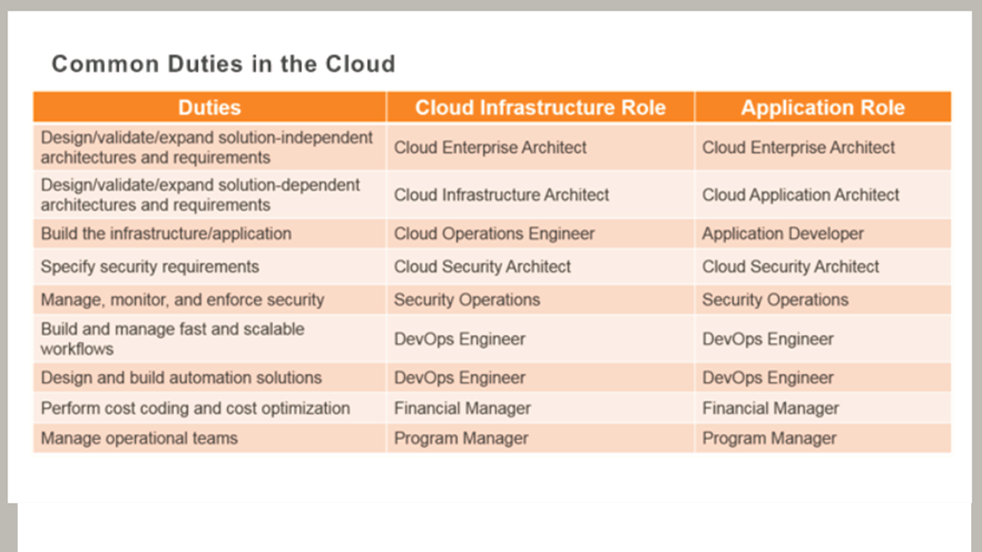

Slide 43


Slide 44


